Slide 1
Büyük Veri
Streaming

Slide 2
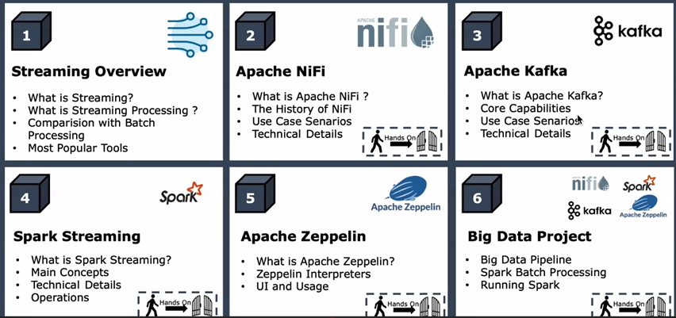
What Is Streaming Data?

Slide 3
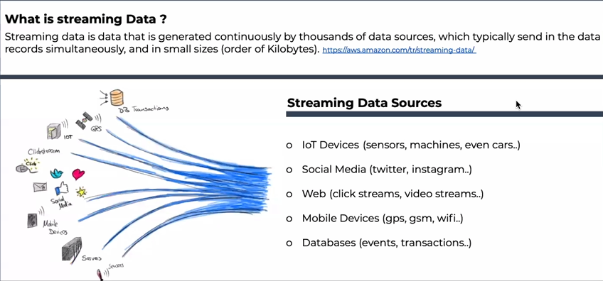
Streaming Overview

Slide 4
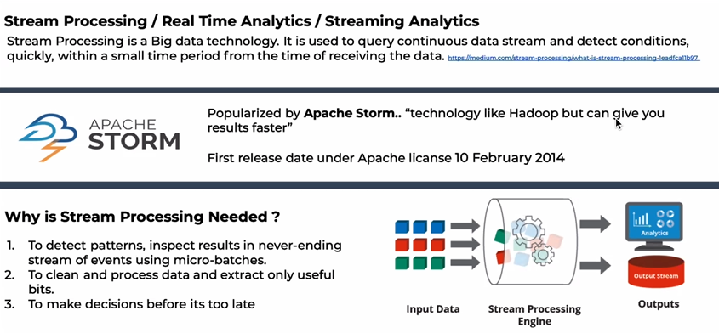
Streaming Overview

Slide 5
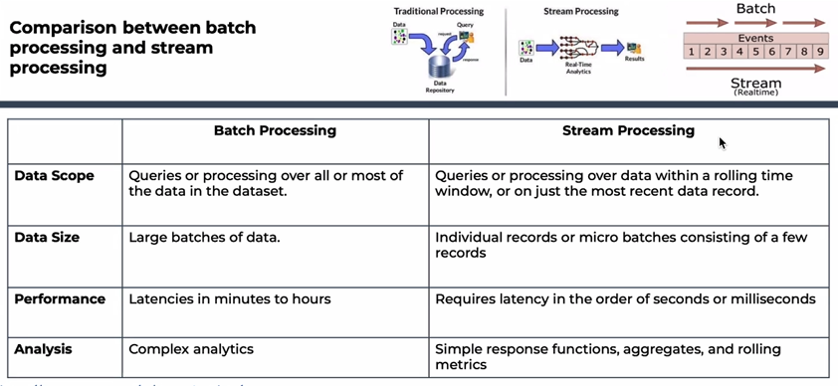
Streaming Overview

Slide 6
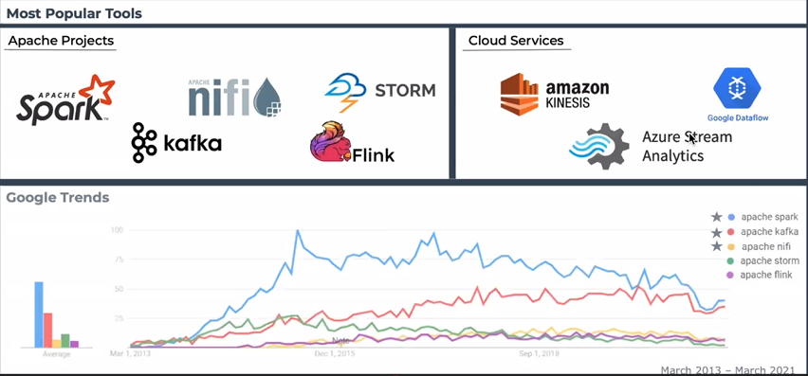
Streaming Overview

Slide 7
Batch Processing
Data Source → File DB queue structure → Analyzing → Results
Real-Time Processing
Data Source → Analyzing →Results

Slide 8
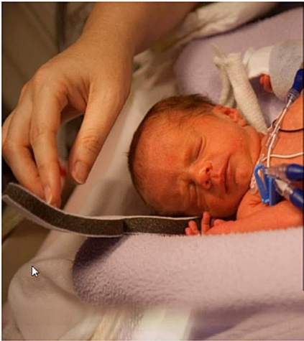
Example : Premature Babies
Ontario Institute of Technology (UOIF) University uses Big Data Technologies for health control of newborn unit.
Advantages:
-detection of life-threatening conditions 24 hours earlier
-improved patient services and low death rates

Slide 9
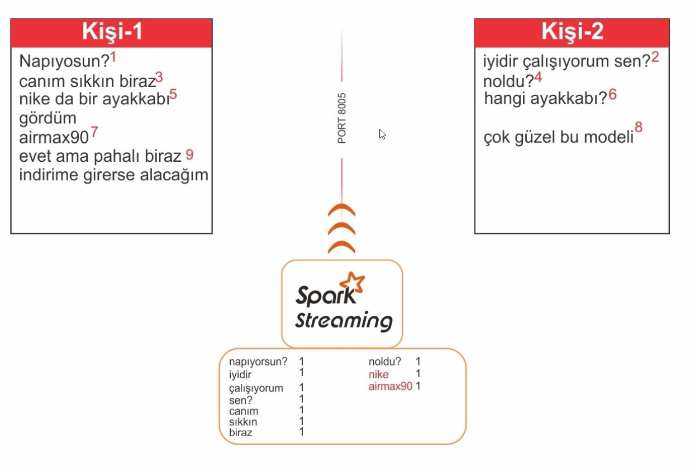
Example: Real-time Message Analysis with Spark Streaming

Slide 10
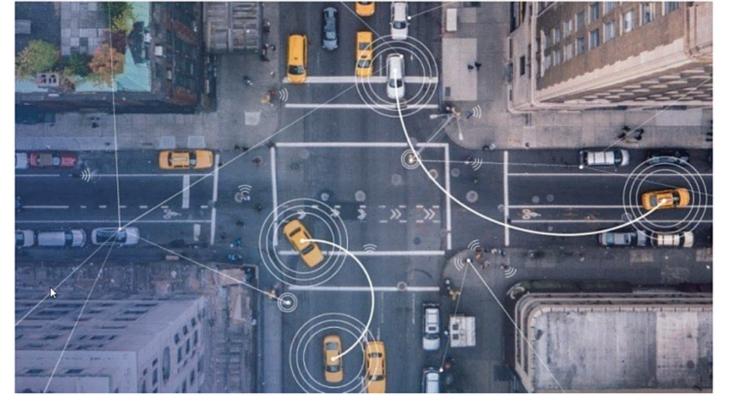
Example: Autonomous Vehicles and Real Time Streaming

Slide 11
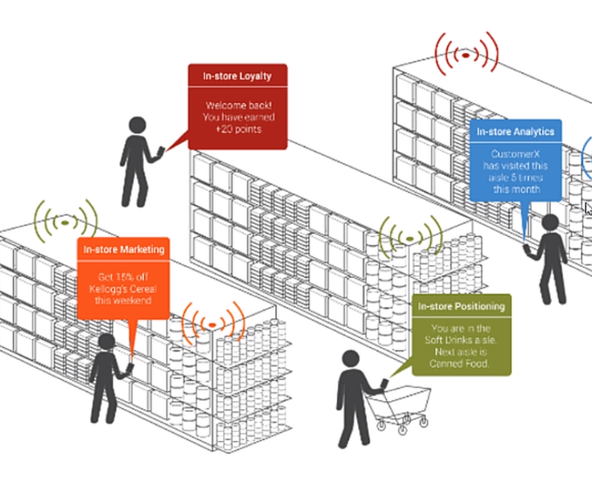
Example: Shopping Center
and Real Time Analysis

Slide 12
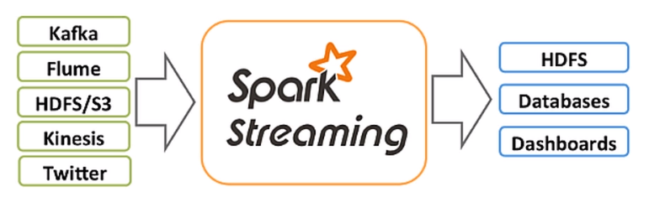
Spark Streaming

Slide 13
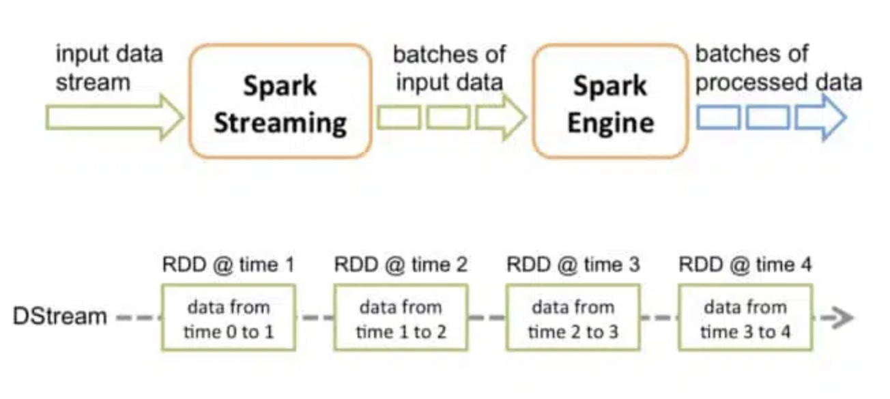
Spark Streaming

Slide 14
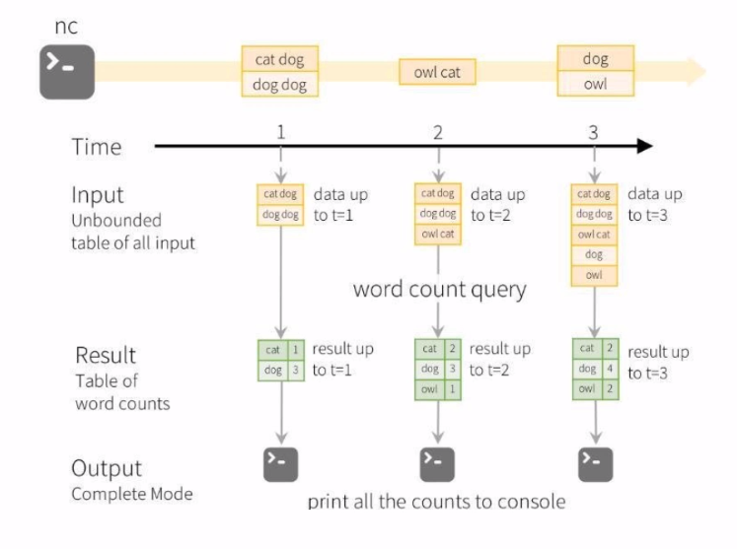
Real-time Message Analysis with Spark Streaming

Slide 15
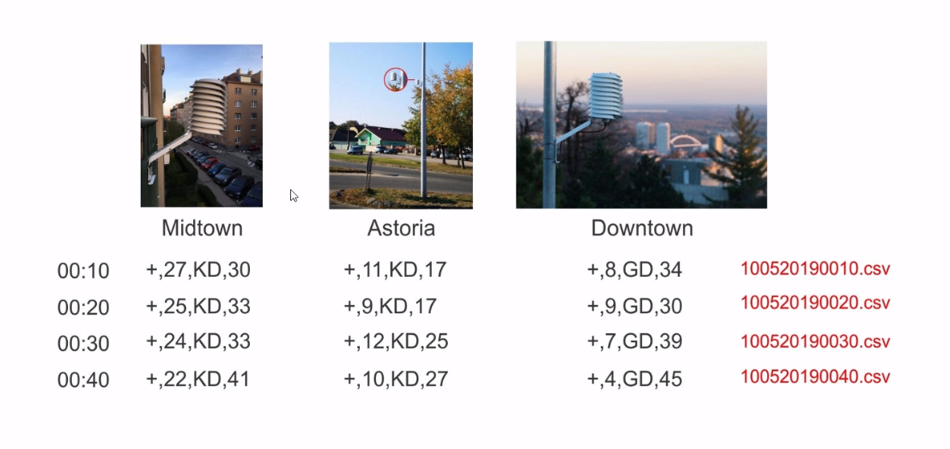
IoT Application

